Slide 1
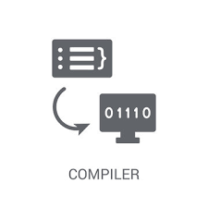
A Syntax Analyzer for Error Detection
A Project Submitted by ,
S.CHANDANA PRIYA(192210091)
K.LAKSHMI(192211986)
M.GAYATHRI(192211888)
COURSE CODE : CSA1499
COURSE NAME : COMPILER DESIGN
FACULTY NAME : Dr. G.MICHAEL

Slide 2
ABSTRACT
This project focuses on the development of a Syntax Analyzer, an essential tool for ensuring code correctness in software development.
Detects syntax errors and unexpected tokens while parsing source code, identifying issues such as missing semicolons, mismatched parentheses, and invalid keywords.
The Syntax Analyzer helps developers catch mistakes early in the development process, reducing debugging time and improving overall code quality.
The project involves designing and implementing a robust lexical analyzer, parser, and error reporting module.
Resulting tool aims to enhance the efficiency of software development by providing precise and user-friendly error detection.

Slide 3
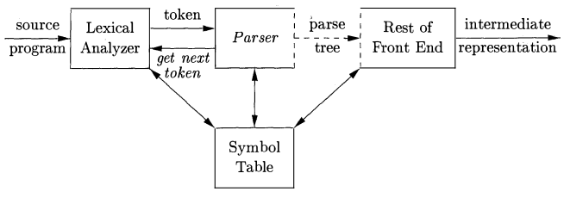
INTRODUCTION
A Syntax Analyzer, a key component of a compiler, identifies syntax errors (ranging from missing semicolons to mismatched parentheses and invalid keywords that can cause compilation failures and runtime errors)early in the development process.
This enables developers to correct mistakes before they propagate through the later stages of development, thereby enhancing code quality and reducing the overall development time.
This project aims to design and implement a Syntax Analyzer capable of detecting a wide range of syntax errors.
The proposed tool will include a lexical analyzer, parser, and an error reporting module. y contributing to more efficient and error-free software development practices.

Slide 4
PROBLEM STATEMENT
The presence of syntax errors in code can lead to compilation failures, runtime errors, and unexpected behavior.
These issues can be time-consuming and costly to debug, especially in large codebases.
Current tools may provide basic syntax checking, but there is a need for a more comprehensive solution that can accurately detect a wide range of syntax errors and provide meaningful feedback to the developer.
The goal of this project is to create a Syntax Analyzer that can efficiently parse source code, detect syntax errors, and report them in a user-friendly manner.

Slide 5
METHODOLOGY
The development of the Syntax Analyzer will follow a structured methodology,
including the following steps:
1.Requirement Analysis:
Identify the types of syntax errors to be detected
2.Design:
Develop the architecture of the syntax analyzer, including the lexical analyzer, parser, and error reporting modules.
3.Implementation:
Write the code for the syntax analyzer.
4.Testing: Test the syntax analyzer with various code samples.
5.Evaluation:
Evaluate the performance of the syntax analyzer

Slide 6
'
1.Requirement Analysis: to detect the following types of syntax errors:
● Missing semicolons
● Mismatched parentheses
● Invalid keywords
● Unexpected tokens
● Incorrect statement structure
2. Design:Consist of the following components:
● Lexical Analyzer: Tokenizes the source code into meaningful symbols.
● Parser: Analyze the token sequence to ensure grammar rules.
● Error Reporting Module: Provides detailed error.
3. Implementation:
The implementation involves writing the code for each component:
A)Lexical Analyzer: It will scan the source code and convert it into a list of tokens. Each token represents a basic element such as keywords, operators, identifiers, and literals.
B)Parser:Takes the list of tokens from the lexical analyzer and check if the token sequence follows the predefined grammar rules. It will detect syntax errors during this process.
C)Error Reporting Module: Generates detailed messages indicating the type and location of the syntax errors.

Slide 7
.
4. Testing :
The syntax analyzer will be tested with a variety of code samples to ensure it correctly detects and reports syntax errors (e.g., missing semicolons,mismatched parentheses, invalid keywords). Test cases will include both syntactically correct and incorrect code snippets.
5. Evaluation :
The performance of the syntax analyzer will be evaluated based on its accuracy in detecting errors and the clarity of the error messages provided. Feedback from users will be incorporated to refine the tool.
SUMMARY:
1.REQUIREMENT ANALYSIS
TYPES OF SYNTAX ERROR
2.DESIGN
ARCHITECTURE OF SYNTAX ANALYSER
3.IMPLEMENTATION
LEXICAL ANALYSER
PARSER
ERROR REPORTING MODULE
4.TESTING
CODE F0R SYNTAX ANALYER
5.EVALUATION
PERFORMANCE OF SYNTAX ANALYZER

Slide 8
THE PARSAR: Syntax Verification: The primary role of the parser is to ensure that the sequence of tokens (generated by the lexical analyzer) adheres to the grammar rules of the programming language. Error Reporting: When the parser encounters a syntax error, it generates an error message indicating the nature of the error and typically provides information about the location in the source code where the error occurred.
THE SYNTAX ANALYSER:
Error Detection: It identifies a syntax error. These errors typically include:
Misplaced or missing
Incorrect use of keywords or operators.
THE LEXICAL ANALYSER:
Tokenization:
The lexer breaks down the source code into tokens such as identifiers, keywords,punctuation symbols, and operators. This process involves recognizing patterns in the source code and converting them into tokens.

Slide 9
C0DE:
#include <stdio.h>
#include <ctype.h>
#include <string.h>
#include <stdlib.h>
typedef enum { TOKEN_INT, TOKEN_RETURN, TOKEN_IDENTIFIER, TOKEN_NUMBER, TOKEN_LPAREN, TOKEN_RPAREN, TOKEN_LBRACE, TOKEN_RBRACE, TOKEN_SEMICOLON, TOKEN_UNKNOWN, TOKEN_EOF} TokenType;
typedef struct {
TokenType type;
char value[100];
} Token;
Token tokens[100];
int token_count = 0;
int current_token = 0;
void add_token(TokenType type, const char *value) {
Token token;
token.type = type;
strcpy(token.value, value);
tokens[token_count++] = token;

Slide 10
void tokenize(const char *code) {
const char *ptr = code;
while (*ptr != '\0') {
if (isspace(*ptr)) {
ptr++;
continue;
}
if (isdigit(*ptr)) {
char number[100];
int len = 0;
while (isdigit(*ptr)) {
number[len++] = *ptr++;
}
number[len] = '\0';
add_token(TOKEN_NUMBER, number);
continue;
}
if (isalpha(*ptr)) {
char identifier[100];
int len = 0;
while (isalnum(*ptr)) {
identifier[len++] = *ptr++;
}

Slide 11
identifier[len] = '\0';
if (strcmp(identifier, "int") == 0) { add_token(TOKEN_INT, identifier);
}
else if (strcmp(identifier, "return") == 0) {
add_token(TOKEN_RETURN, identifier);
}
else {
add_token(TOKEN_IDENTIFIER, identifier);
}
continue;
}
switch (*ptr) {
case '(': add_token(TOKEN_LPAREN, "("); break; case ')': add_token(TOKEN_RPAREN, ")"); break; case '{': add_token(TOKEN_LBRACE, "{"); break; case '}': add_token(TOKEN_RBRACE, "}"); break; case ';': add_token(TOKEN_SEMICOLON, ";"); break; default: add_token(TOKEN_UNKNOWN, (char[]){*ptr, '\0'}); break;
}
ptr++;
} add_token(TOKEN_EOF, "EOF");}

Slide 12
void syntax_error(const char *message)
{
printf("Syntax Error: %s\n", message);
exit(1);
}
void match(TokenType expected_type)
{
if (current_token < token_count && tokens[current_token].type == expected_type) {
current_token++;
}
else
{
char err_msg[100];
sprintf(err_msg, "Expected %d but found %d ('%s')", expected_type,
tokens[current_token].type, tokens[current_token].value); syntax_error(err_msg);
}
}
void statement() {
match(TOKEN_RETURN);
match(TOKEN_NUMBER);
match(TOKEN_SEMICOLON);
}

Slide 13
void function() {
match(TOKEN_INT);
match(TOKEN_IDENTIFIER);
match(TOKEN_LPAREN);
match(TOKEN_RPAREN);
match(TOKEN_LBRACE);
statement();
match(TOKEN_RBRACE);}
void parse() {
function();
if (current_token < token_count - 1)
{
syntax_error("Unexpected tokens at the end");
}
else {
printf("Parsing successful!\n");
}
}
void run_test(const char *code) {
printf("Testing code: %s\n", code);
tokenize(code);
parse();
current_token = 0; // Reset for next test case token_count = 0;}

Slide 14
int main() {
// Valid code
const char *code_valid = "int main() { return 0; }"; run_test(code_valid);
// Missing semicolon const char *code_missing_semicolon = "int main() { return 0 }"; run_test(code_missing_semicolon);
return 0;}

Slide 15
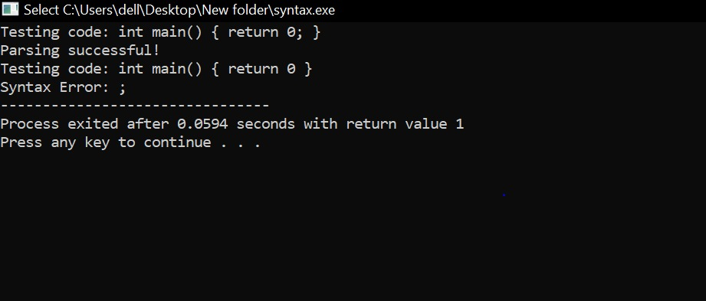
OUTPUT

Slide 16
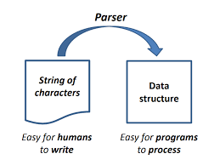
CONCLUSION
The Syntax Analyzer project aims to enhance software development by ensuring code correctness through the early detection of syntax.
This tool automatically identifies common mistakes errors.
Comprising a lexical analyzer, parser, and error reporting module, the Syntax Analyzer provides precise and user-friendly feedback, enabling developers to correct errors promptly and efficiently.
This project highlights the critical role of syntax analysis in compiler design and its contribution to producing robust, error-free software.

Slide 17
THANKYOU
.

